Slide 1
IMO
File created on: 7/30/20 3:21:53 PM EDT

Slide 2
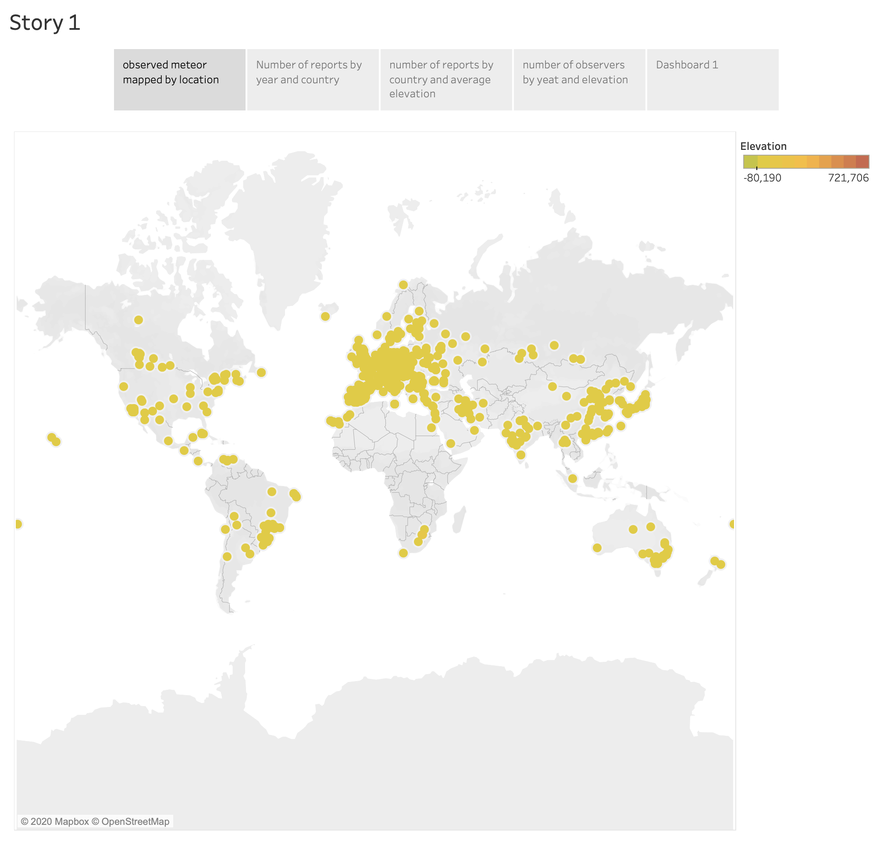

Slide 3
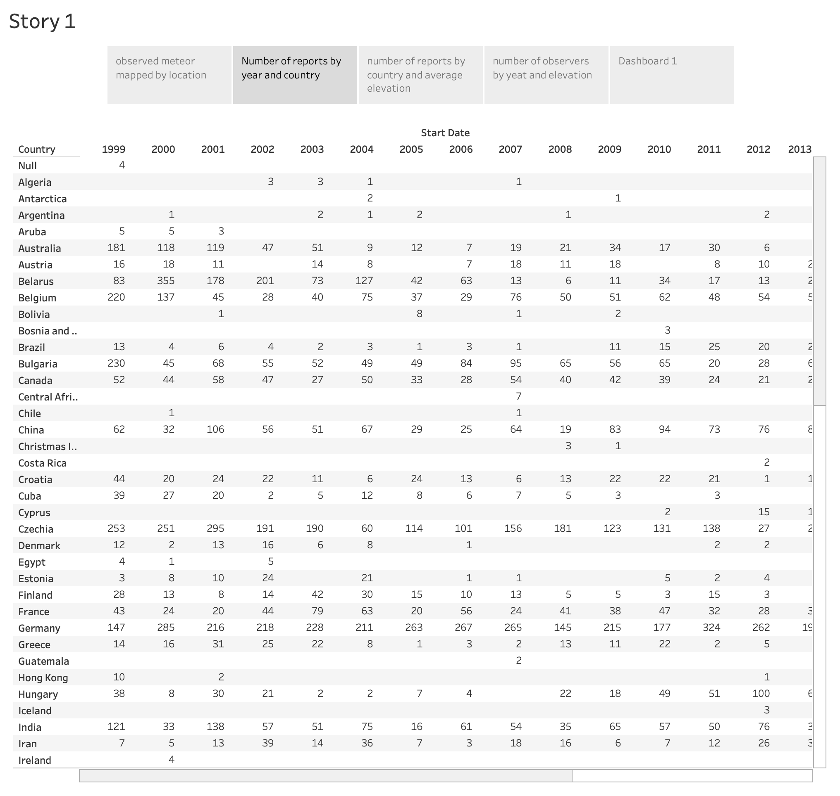

Slide 4
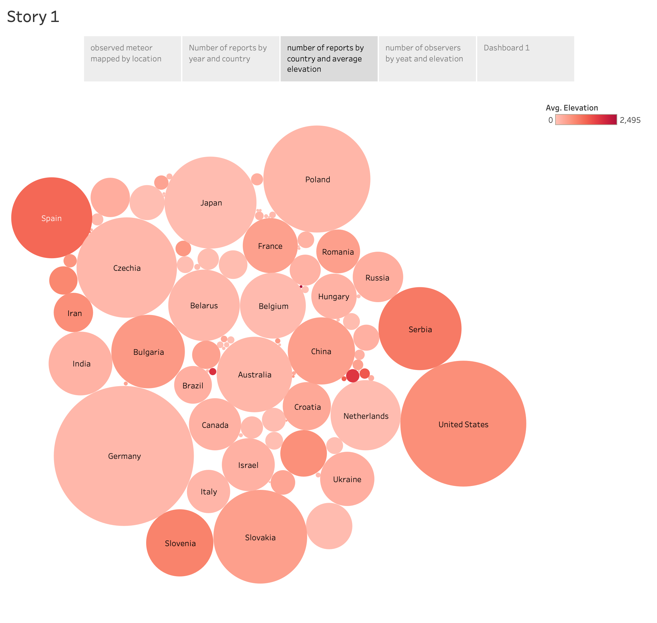

Slide 5
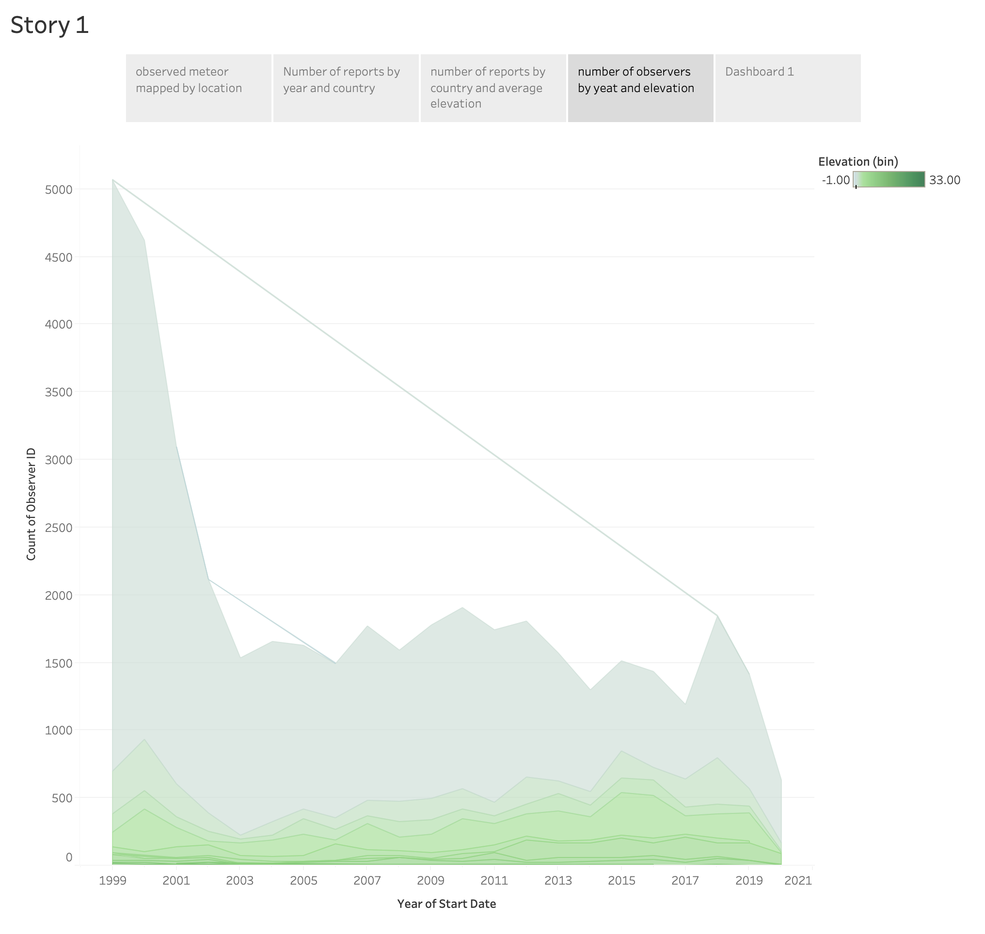

Slide 6
